Slide 1


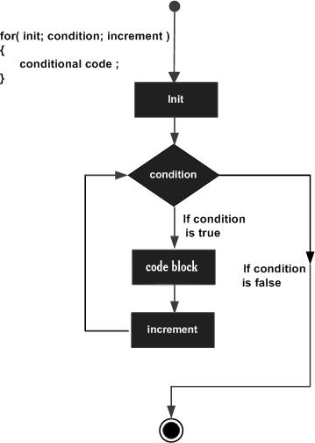
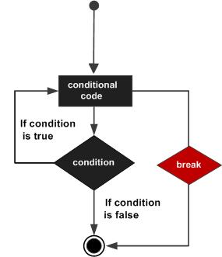
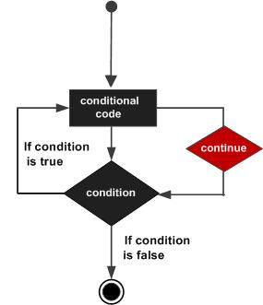
G.H.Raisoni College of Engineering and Management, Pune (An Autonomous Institute Affiliated to Savitribai Phule Pune University)
(1st year Department)
Sub:-Computer Programming.
Topic – for ,break ,continue
for loop in C
A for loop is a repetition control structure that allows you to efficiently write a loop that needs to execute a specific number of times.
Syntax
The syntax of a for loop in C programming language is −
for ( init; condition; increment ) { statement(s); }
break Statement in C
When a break statement is used inside a loop, the loop is immediately terminated and the program control resumes at the next statement following the loop.
Syntax
The syntax for a break statement in C is as follows − break;
continue Statement in C
The continue statement causes the conditional test and increment portions of the loop to execute.
Syntax
The syntax for a continue statement in C is as follows − continue;
Guided By:- DNYANESHWAR KOKARE, NITESH DANGARE
Presented By:- Sushma D. Yemmewar (C-69), Swayam P. Terode (C-70), Tanmay R. Aswale (C-71), Vallabh R. Shrimangale (C-72)

